Slide 1
Natural Selection and Microbiomes
biological data science
spring 2019

Slide 2
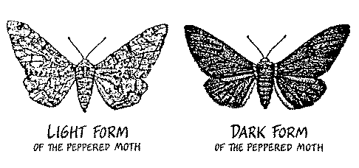
Natural Selection
Darwin’s Principles
Variation
Heritability
Selection
Ability to survive and reproduce in a given environment
https://www.youtube.com/watch?v=aTftyFboC_M
When the pollution was reduced the light form of the peppered moth became the most common type again!

Slide 3

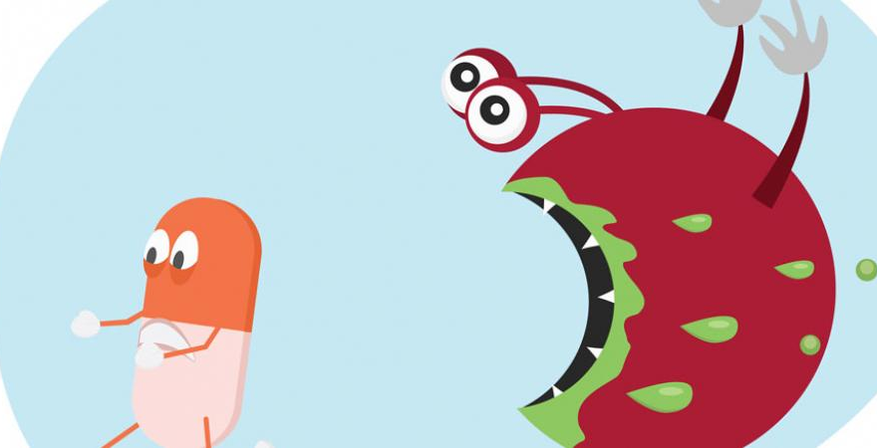
Antibiotic Resistance
Bacteria have short life cycles
Rapid evolution is possible
https://www.youtube.com/watch?v=plVk4NVIUh8

Slide 4
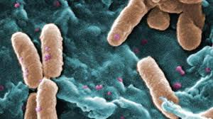
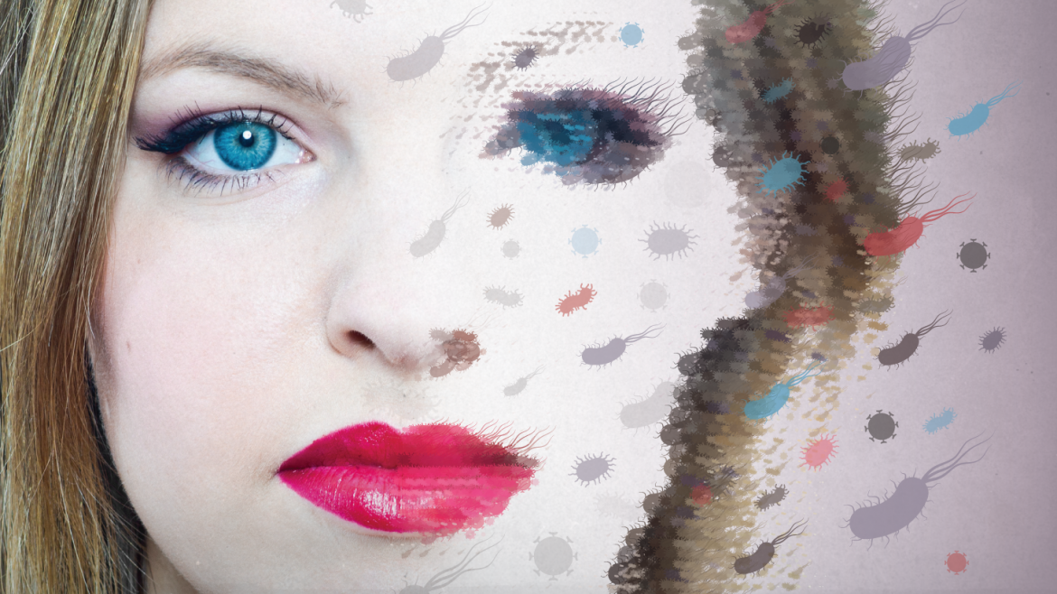

Slide 5
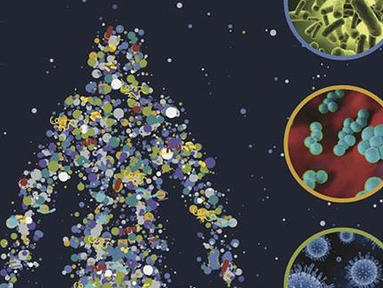
Microbiome
Microorganisms that live on or within our bodies
https://www.youtube.com/watch?v=A-IqdPch9t0
https://www.youtube.com/watch?v=Ybk7E7SLbWw

Slide 6
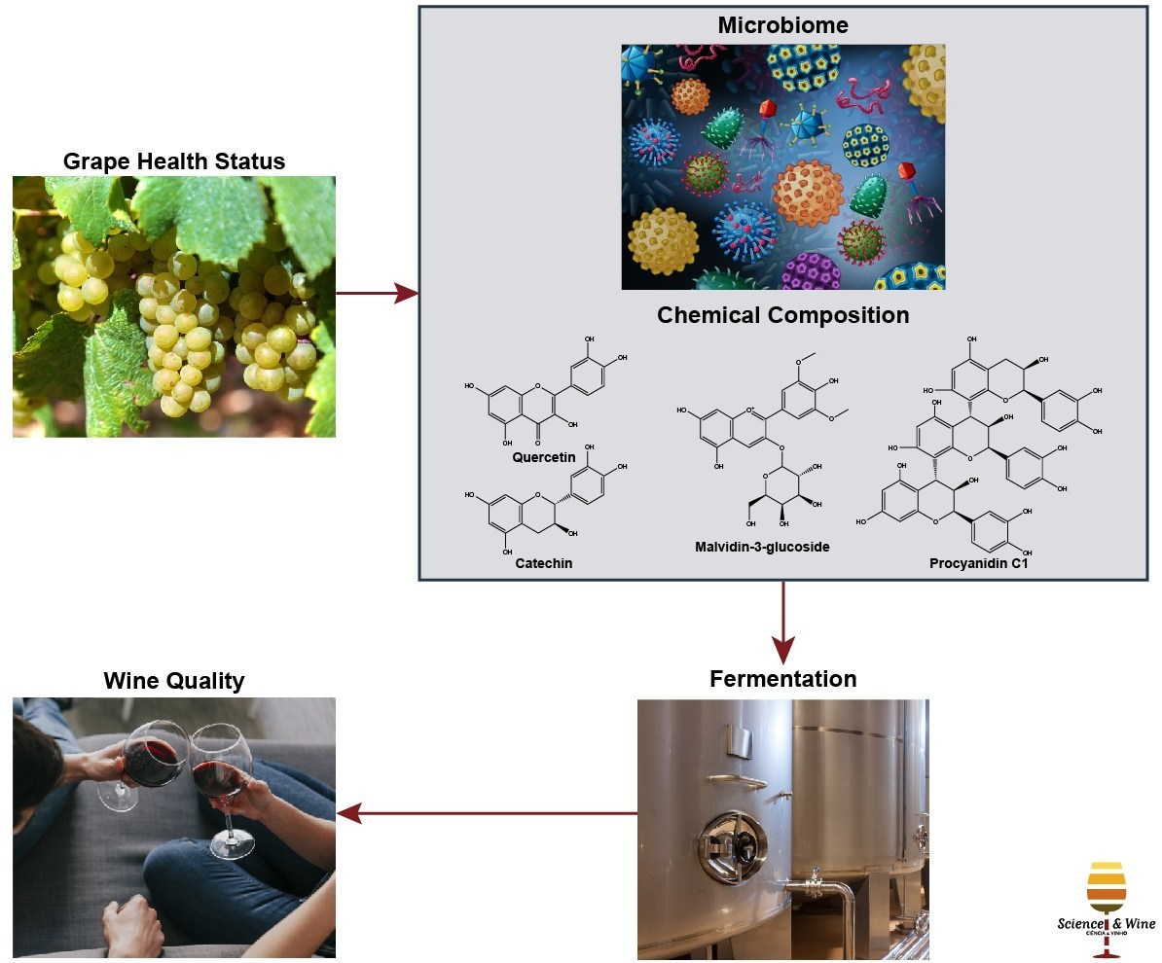
Dan Jacobson’s PhD Dissertation

